Slide 1
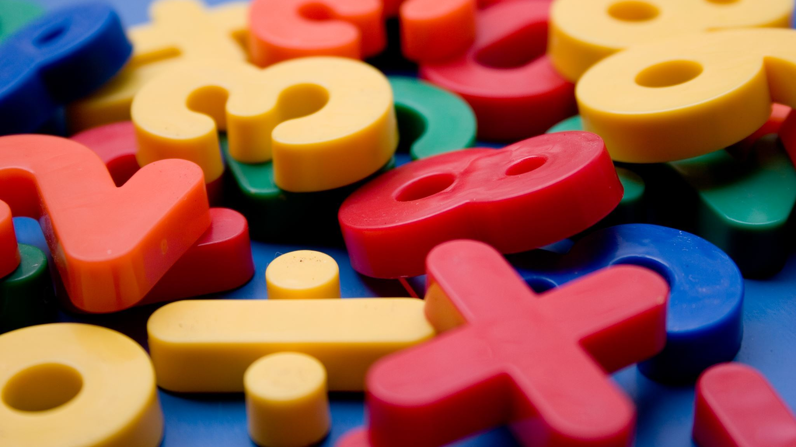
Tic tac Toe in Python by Justin Mims

Slide 2
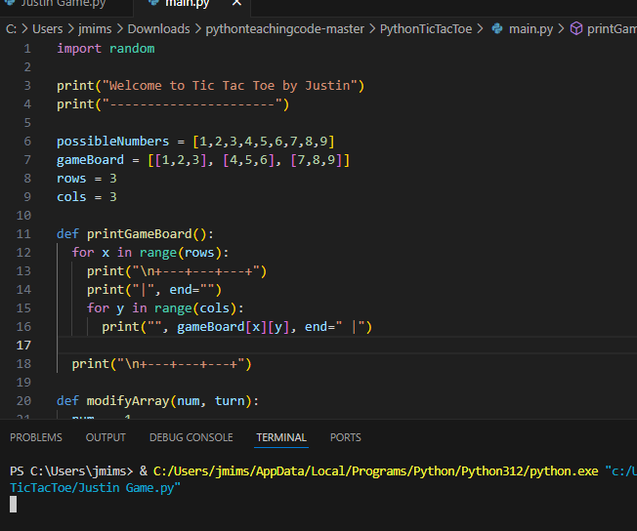
What was the idea and what source could do you use ?
I decided to make a tic tak toe go within python one against the computer and the other is for playing with friends.
Mainly I found youtube to be a helpful source on this project

Slide 3
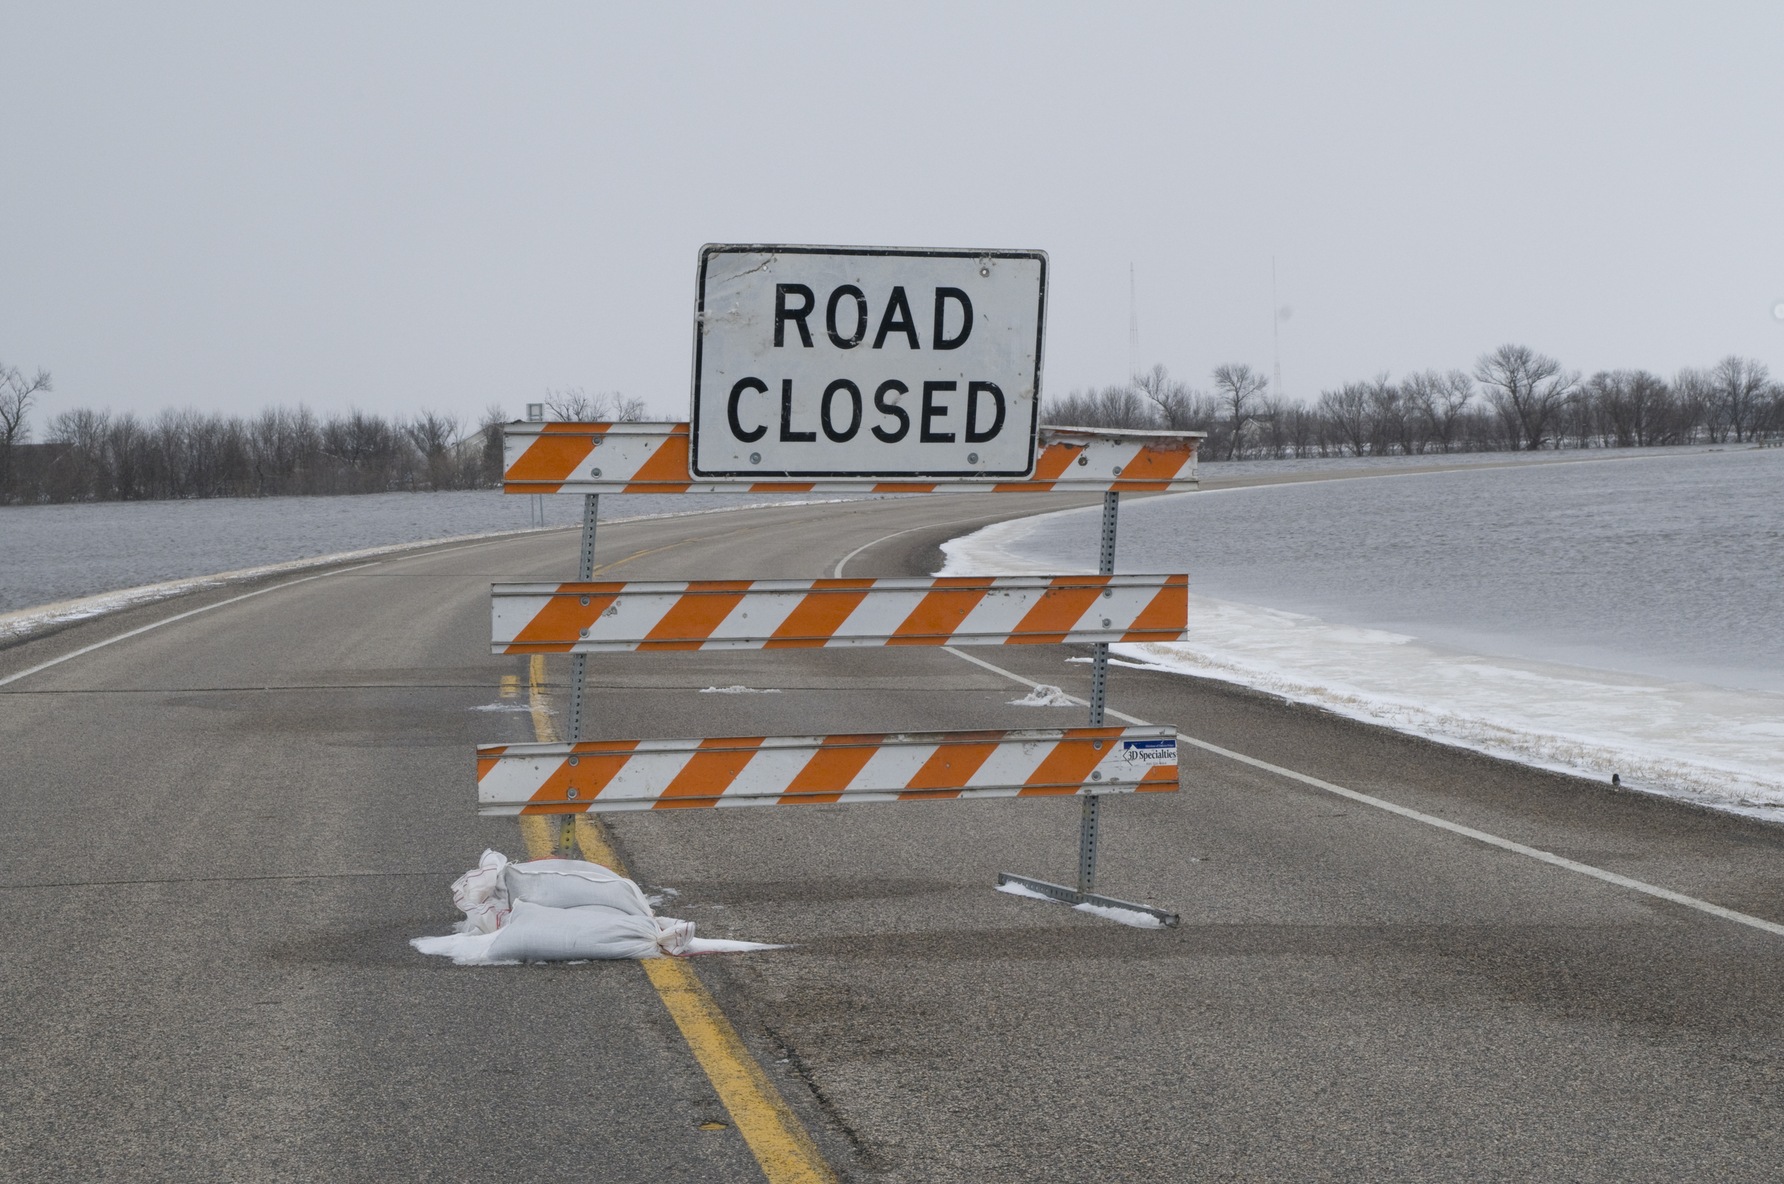
What road blocks did I face
I faced many roadblocks just making simple errors and not closing my statements.
Im very new to python so this project required me to seek a lot help but I gained a better understanding of the program.
What surprised was how difficult and time consuming this could be for a beginner but I eventually got the hang of unit through youtube.
ThePhoto by PhotoAuthor is licensed under CCYYSA.
ThePhoto by PhotoAuthor is licensed under CCYYSA.

Slide 4
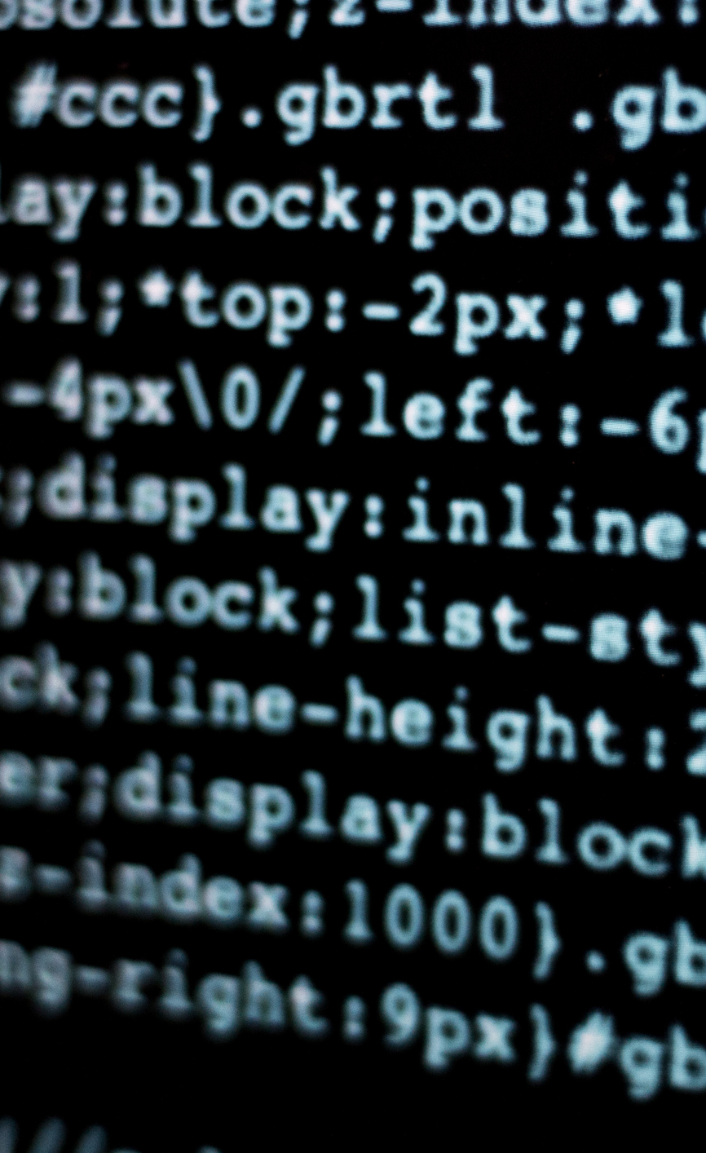
How did my project develop
Originally I wanted to do a nfl stat tracking project for people who like to gamble but I found that I was a little in over my head so I decided to make a fun game through python.

Slide 5
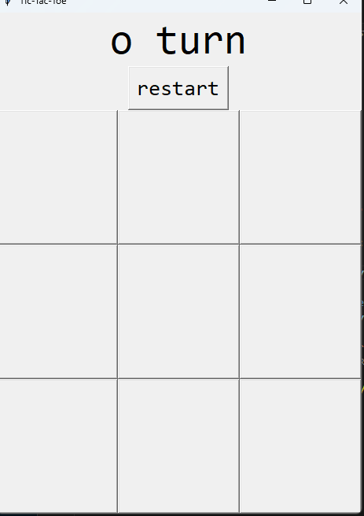
Time to run the code !!!

Slide 6
Thank you

